Slide 1
ANALYTICAL REPORT
February 2022 profit margin: a seasonal operations problem, not a product problem
TechWorld · 2,008 order lines, Q1 2022
Prepared for: Executive team · 2026-10-11

Slide 2
EXECUTIVE SUMMARY
The margin fell -15.3pp in February and recovered to 30.0% in March; the drop was broad-based and went with a surge in returns
SITUATION
TechWorld sells consumer electronics online in 4 regions; January 2022 had 713 order lines at a profit margin of 29.6%.
ANSWER
The profit margin fell from 29.6% to 14.3% in February (-15.3pp) and recovered to 30.0% in March. The drop was broad-based across every category and region and went with the return rate rising from 3.5% to 27.9%; orders delivered in more than 7 days were returned 37.2% of the time vs 10.0%. The priority is a delivery plan for peak season, not a change in product mix.
COMPLICATION
In February 2022 the profit margin fell to 14.3% (-15.3pp).
KEY ARGUMENTS
1
February is the break point of the quarter (-15.3pp) and March recovered to 30.0%: the problem is timing-related.
QUESTION
Which area drove the February margin drop, and what must be fixed before Q2 so it does not repeat?
2
No single area carries the drop: Electronics fell -14.5pp, the other categories -21.3pp; the four regions differ by 2.6pp; every channel fell.
3
Returns rose evenly across the main categories (+22.0pp to +23.1pp); orders delivered in more than 7 days were returned 37.2% of the time vs 10.0%.
DO NOW
→ Reserve delivery capacity for Lunar New Year 2023 and line up a backup carrier
→ Track the return rate weekly and alert when it exceeds 10.0% (the on-time delivery level)
Source: techworld_ecommerce_teaching_Q1_2022.csv (2,008 rows after filters); base period 2022-01, comparison period 2022-02.
02 / 13

Slide 3
METHODOLOGY
A segmentation issue tree with 6 hypotheses, tested in ICE order
B1 · Product category
ID | Hypothesis | Test | ICE | Result
H1 | The margin drop is concentrated in one product category. | segment_delta | 540 | Rejected
H2 | February is the break point of the quarter and March recovers. | trend_break | 490 | Supported
H3 | Orders delivered in more than 7 days have a much higher return rate. | binary_split | 432 | Supported
H4 | The return rate rose in every category in February. | uniform | 300 | Supported
H5 | The margin fell evenly across all regions (not a local problem). | uniform | 250 | Supported
H6 | The margin fell evenly across all traffic channels (not one ad channel getting more expensive). | uniform | 200 | Rejected
B2 · Timing of the break
Δ profit margin January → February
B3 · Operations: delivery and returns
B4 · Region and channel
ME: Each order line belongs to exactly one category, one region and one channel; revenue-weighted shift-share adds up exactly to the total margin Δ.
CE: The total Δ equals the sum of every category's contribution; the operations branch (delivery, returns) is tested by group comparison; fixed costs are outside the data and recorded in boundaries.
Source: techworld_ecommerce_teaching_Q1_2022.csv (2,008 rows after filters); base period 2022-01, comparison period 2022-02.
03 / 13

Slide 4
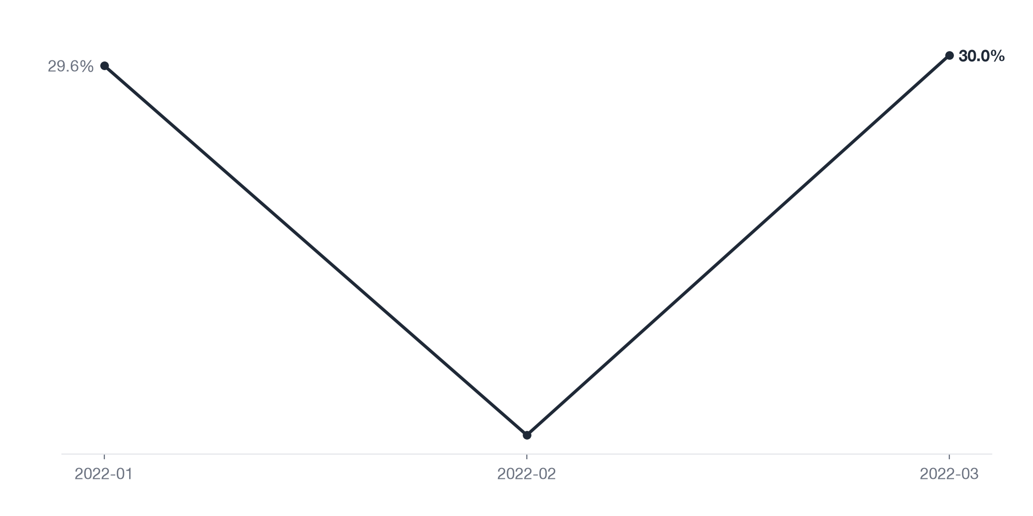
WHEN
The profit margin fell from 29.6% to 14.3% in February, then recovered to 30.0% in March
-15.3pp
Change in Profit margin, period 2022-02 vs previous period
+15.7pp
Change in Profit margin, period 2022-03 vs previous period
27.9%
Return rate 2022-02
SO WHAT
A single broken month followed by a recovery points to a timing-related incident (Lunar New Year) that needs a seasonal plan rather than restructuring.
Source: techworld_ecommerce_teaching_Q1_2022.csv (2,008 rows after filters); base period 2022-01, comparison period 2022-02.
04 / 13

Slide 5
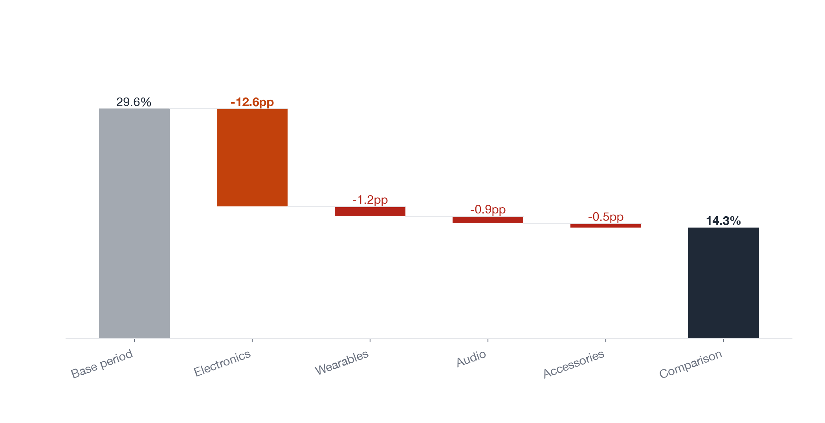
BROAD-BASED
Electronics accounts for 82.3% of the drop but did not fall the most: -14.5pp vs -21.3pp in the other categories
82.3%
% of the total change from Electronics
-14.5pp
Change in Profit margin, Category=Electronics
-21.3pp
Change in Profit margin for all other Category values
SO WHAT
Its large share only reflects Electronics' revenue size; cutting Electronics would not fix the margin.
Source: techworld_ecommerce_teaching_Q1_2022.csv (2,008 rows after filters); base period 2022-01, comparison period 2022-02.
05 / 13

Slide 6
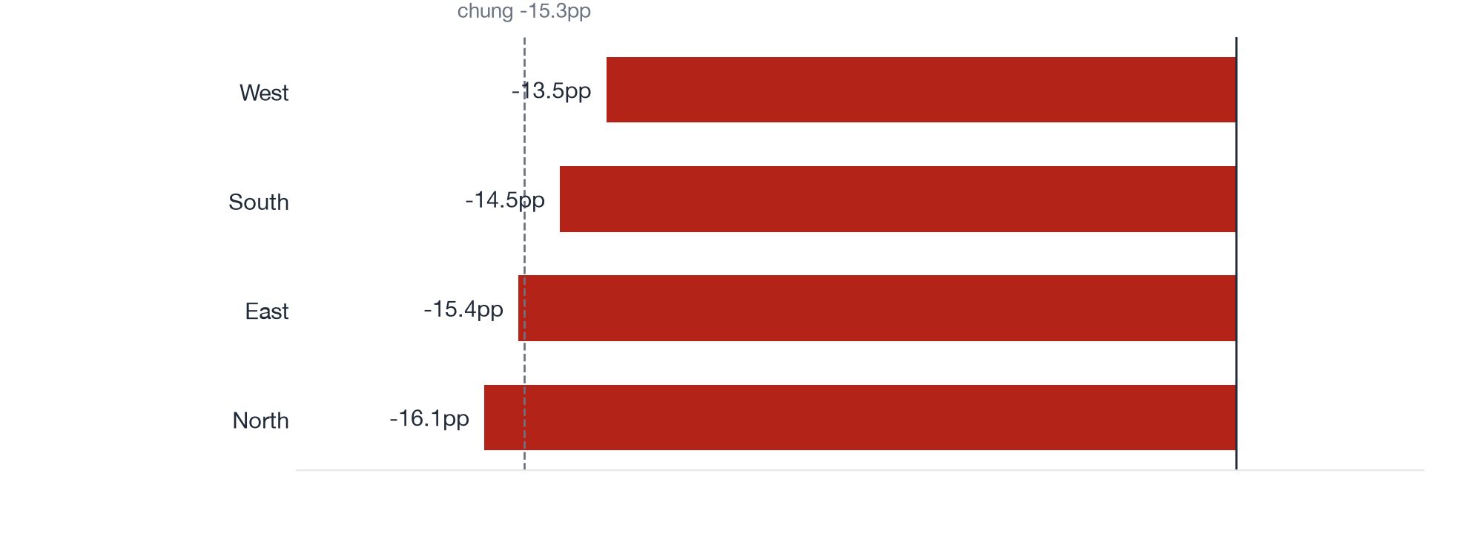
BROAD-BASED
The four regions fell by almost the same amount, only 2.6pp apart
2.6pp
Max−min spread of the change across Region
14.9pp
Typical size of the change (median |Δ|) across Region
SO WHAT
Rules out a local cause; the problem sits in a step shared by every region.
Source: techworld_ecommerce_teaching_Q1_2022.csv (2,008 rows after filters); base period 2022-01, comparison period 2022-02.
06 / 13

Slide 7
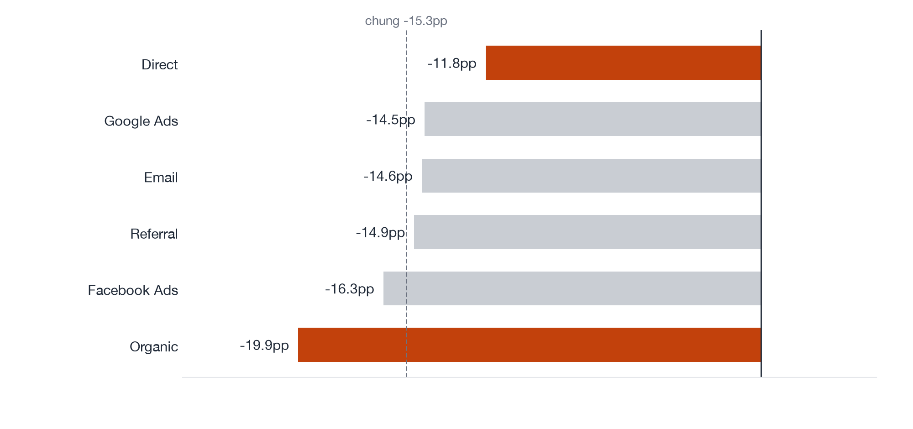
BROAD-BASED
The margin fell in every traffic channel, most in Organic (-19.9pp) and least in Direct (-11.8pp)
-19.9pp
Change in Profit margin, Traffic_Source=Organic
-11.8pp
Change in Profit margin, Traffic_Source=Direct
8.1pp
Max−min spread of the change across Traffic_Source
SO WHAT
An 8.1pp gap between channels is not enough to make marketing the main cause, since the channel with no ad spend (Organic) fell the most.
Source: techworld_ecommerce_teaching_Q1_2022.csv (2,008 rows after filters); base period 2022-01, comparison period 2022-02.
07 / 13

Slide 8
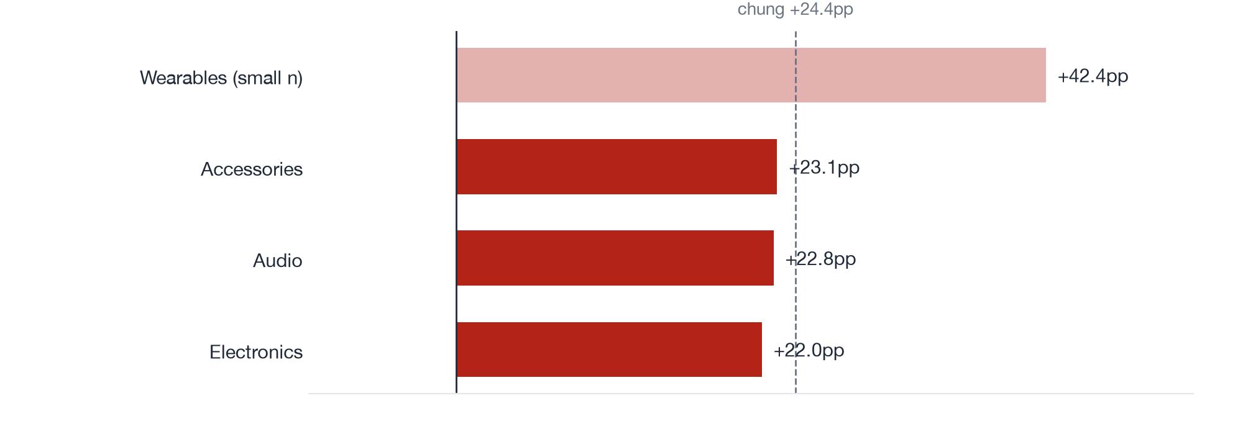
GOES WITH RETURNS
Return rates rose almost equally in the three main categories, from +22.0pp to +23.1pp; Wearables (small sample) rose +42.4pp
3.5%
Return rate 2022-01
27.9%
Return rate 2022-02
1.1pp
Max−min spread of the change across Category
SO WHAT
Returns rose evenly, so the cause sits in a shared step (delivery), not in the quality of one product line.
Source: techworld_ecommerce_teaching_Q1_2022.csv (2,008 rows after filters); base period 2022-01, comparison period 2022-02.
08 / 13

Slide 9
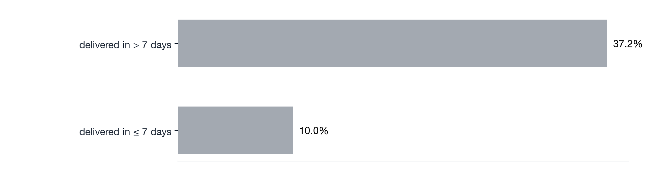
GOES WITH RETURNS
Orders delivered in more than 7 days were returned 37.2% of the time, nearly four times the on-time rate (10.0%)
37.2%
Return rate, group delivered in > 7 days
10.0%
Return rate, group delivered in ≤ 7 days
384
Rows in group delivered in > 7 days
SO WHAT
Late delivery goes with high returns; this is a correlation, and carrier data is needed to confirm the cause.
Source: techworld_ecommerce_teaching_Q1_2022.csv (2,008 rows after filters); base period 2022-01, comparison period 2022-02.
09 / 13

Slide 10
HYPOTHESIS TESTING
4 hypotheses supported by the data, 2 rejected, 0 not testable with the current data
ID | Hypothesis | Result | Evidence
H1 | The margin drop is concentrated in one product category. | Rejected | Category = Electronics: 28.6% → 14.0% (-14.5pp), 82.3% of the total change of -15.3pp; all other Category values -21.3pp. The large contribution comes from the size of Electronics, not fr…
H2 | February is the break point of the quarter and March recovers. | Supported | Profit margin by period: 2022-01 29.6%, 2022-02 14.3%, 2022-03 30.0%. Worst period: 2022-02 (-15.3pp).
H3 | Orders delivered in more than 7 days have a much higher return rate. | Supported | Return rate: delivered in > 7 days 37.2% vs delivered in ≤ 7 days 10.0% (gap +27.2pp).
H4 | The return rate rose in every category in February. | Supported | By Category (all rows): Accessories +23.1pp, Audio +22.8pp, Electronics +22.0pp. Spread across groups 1.1pp vs a typical change of 22.8pp → the change is uniform.
H5 | The margin fell evenly across all regions (not a local problem). | Supported | By Region (all rows): East -15.4pp, North -16.1pp, South -14.5pp, West -13.5pp. Spread across groups 2.6pp vs a typical change of 14.9pp → the change is uniform.
H6 | The margin fell evenly across all traffic channels (not one ad channel getting more expensive). | Rejected | By Traffic_Source (all rows): Direct -11.8pp, Email -14.6pp, Facebook Ads -16.3pp, Google Ads -14.5pp, Organic -19.9pp, Referral -14.9pp. Spread across groups 8.1pp vs a typical change of…
Source: techworld_ecommerce_teaching_Q1_2022.csv (2,008 rows after filters); base period 2022-01, comparison period 2022-02.
10 / 13

Slide 11
RECOMMENDATIONS
Priority: prepare peak-season logistics and track returns weekly
# | Action | Owner | Timeline | KPI to track | Type
1 | Reserve delivery capacity for Lunar New Year 2023 and line up a backup carrier — Shrink the group of orders with a 37.2% return rate | Head of Operations | Before December 2022 | Share of orders delivered in more than 7 days | Quick win
2 | Track the return rate weekly and alert when it exceeds 10.0% (the on-time delivery level) | Head of Customer Service | Within 2 weeks | Weekly return rate | Quick win
3 | Put a maximum 7-day delivery SLA and late-delivery penalties into carrier contracts — Bring the return rate from 27.9% back toward January's 3.5% | Procurement Manager | Q2 2022 | Monthly return rate | Big project
4 | Capture the carrier and the return reason for every order to isolate the cause of late deliveries | Data Lead | Within 1 month | Share of returned orders with a recorded reason | Big project
Source: techworld_ecommerce_teaching_Q1_2022.csv (2,008 rows after filters); base period 2022-01, comparison period 2022-02.
11 / 13

Slide 12
LIMITATIONS
What the current data cannot answer
• There is no fixed-cost data, so Net_Profit is order-level profit.
• There is no carrier information, so the cause of late deliveries cannot be isolated.
• Only Q1 2022 is available; no same-period comparison with the previous year.
NEXT STEPS
→ Join carrier data to test the hidden-variable hypothesis (a partner that is both slow and damages goods).
→ Compare with the previous year's Lunar New Year once the data is available.
Source: techworld_ecommerce_teaching_Q1_2022.csv (2,008 rows after filters); base period 2022-01, comparison period 2022-02.
12 / 13

Slide 13
APPENDIX
KPI definitions, filters and data volume
• Primary KPI: Profit margin — Sum of Net_Profit / sum of Sales
• Dataset: techworld_ecommerce_teaching_Q1_2022.csv · 2,008 raw rows · 2,008 rows after filters
• Filters: none
• Comparison: base = 2022-01, comp = 2022-02; periods in the data: 2022-01, 2022-02, 2022-03
• Shift-share decomposition: total Δ = Σ rate effect (performance within each group) + Σ mix effect (group mix).
• Every number in this deck traces back to facts.json (QA gate).
Source: techworld_ecommerce_teaching_Q1_2022.csv (2,008 rows after filters); base period 2022-01, comparison period 2022-02.
13 / 13

