Slide 1
ANALYTICAL REPORT
August 2023 transaction success rate: where the problem is and what to fix first
Analysis of 32,122 transactions, July–August 2023 · E-Wallet
Prepared for: Executive team · 2026-10-11

Slide 2
EXECUTIVE SUMMARY
The success rate fell -4.7pp, mostly in Billing; September's priority is Billing capacity, starting with authentication
SITUATION
The e-wallet processed 14,662 transactions in July and 17,460 in August 2023 across Android, iOS and Web; the July success rate was 91.7%.
ANSWER
The success rate fell -4.7pp, mostly in Billing: Billing accounts for 64.5% of the drop (86.3% → 71.8%) in the same month Billing volume rose +50.0%. Failures rose on every platform, every payment method and every error type, so September's priority is the processing capacity of the Billing flow, starting with authentication, the error type behind 54.0% of the additional failures.
COMPLICATION
In August 2023 the success rate fell to 86.9% (-4.7pp), about 828 more failed transactions than if the July rate had held.
KEY ARGUMENTS
1
Billing accounts for 64.5% of the wallet-wide drop: Billing's success rate fell -14.5pp while all other categories fell only -2.0pp, just as Billing transactions rose +50.0%.
QUESTION
Where should September's engineering capacity go to bring the success rate back to the July level?
2
Every error type rose within Billing; authentication is the largest (192 → 544 cases, 54.0% of the additional failures), the other types rose 3.5x.
3
Three platforms and four payment methods dropped by about the same amount (spreads of 3.2pp and 3.8pp), so this is neither an app bug nor the fault of one payment partner.
DO NOW
→ Monitor the Billing success rate hourly and alert when it drops below the July level (86.3%)
→ Load-test the OTP gateway and the Billing backend at 3,420 transactions/month; raise the quota or add a backup SMS provider
Source: transactions_enhanced.csv (32,122 rows after filters); base period 7/2023, comparison period 8/2023.
02 / 14

Slide 3
METHODOLOGY
A segmentation issue tree with 7 hypotheses, tested in ICE order
B1 · Product category
ID | Hypothesis | Test | ICE | Result
H1 | The drop is concentrated in one category rather than spread evenly. | segment_delta | 630 | Supported
H2 | Within the most affected category, authentication errors (OTP/PIN) make up the majority of August failures. | composition | 432 | Supported
H3 | Within the most affected category, every platform dropped about the same, so the fault is server-side… | uniform | 420 | Supported
H4 | Within the most affected category, every payment method dropped about the same, so it is not the fault of… | uniform | 300 | Supported
H5 | Transaction volume in the most affected category rose sharply in August. | segment_delta | 300 | Supported
H6 | Inside the most affected category, the drop is spread evenly across bill sub-categories. | uniform | 250 | Rejected
H7 | Users drop off between authentication and payment confirmation and retry several times. | not_testable |  | Not testable
B2 · Error type
Δ success rate July → August
B3 · Platform: client or server
B4 · Payment method
B5 · Step-by-step payment flow
ME: Each transaction belongs to exactly one category, one platform and one payment method; shift-share splits Δ into rate effect + mix effect that add up exactly to the total Δ.
CE: The total Δ equals the sum of the contributions of every category (including Not Payment), so nothing sits outside the tree. The branch with no column (funnel steps) is recorded in boundaries.
Source: transactions_enhanced.csv (32,122 rows after filters); base period 7/2023, comparison period 8/2023.
03 / 14

Slide 4
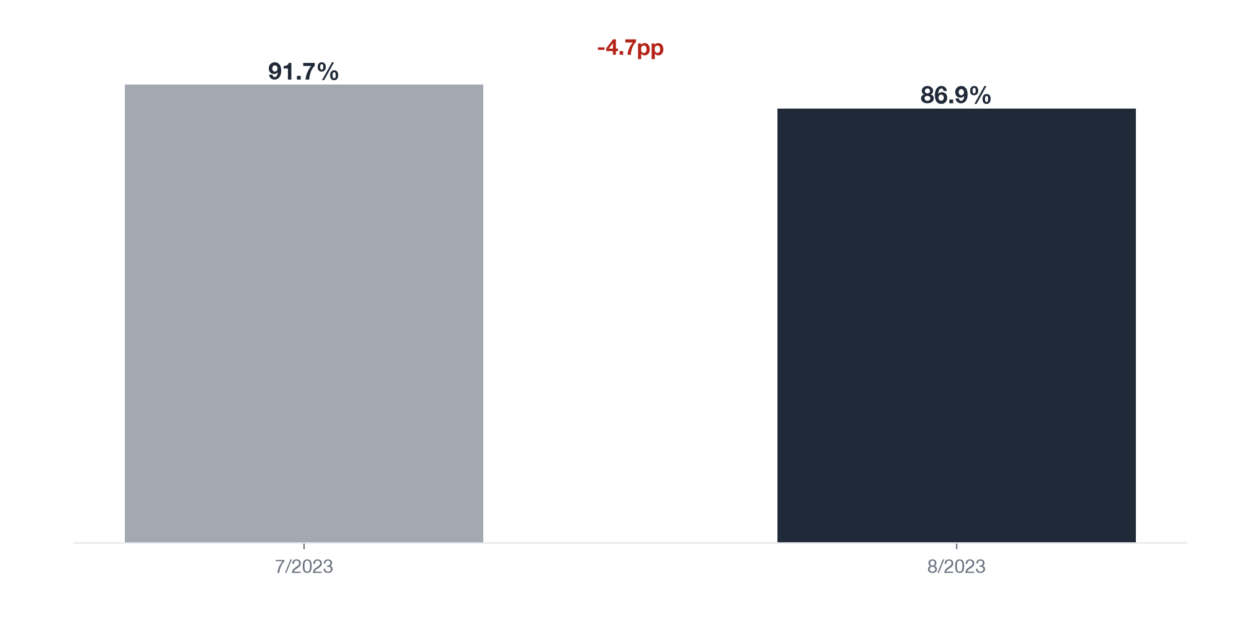
WHERE
The transaction success rate fell from 91.7% to 86.9% (-4.7pp) in August, about 828 excess failed transactions
-4.7pp
Change in Transaction success rate 7→8
828
Excess failed cases vs the 7 rate
2,281
Failed cases in period 8
SO WHAT
The drop is large enough to localise before fixing: the total can hide one group that is collapsing.
Source: transactions_enhanced.csv (32,122 rows after filters); base period 7/2023, comparison period 8/2023.
04 / 14

Slide 5
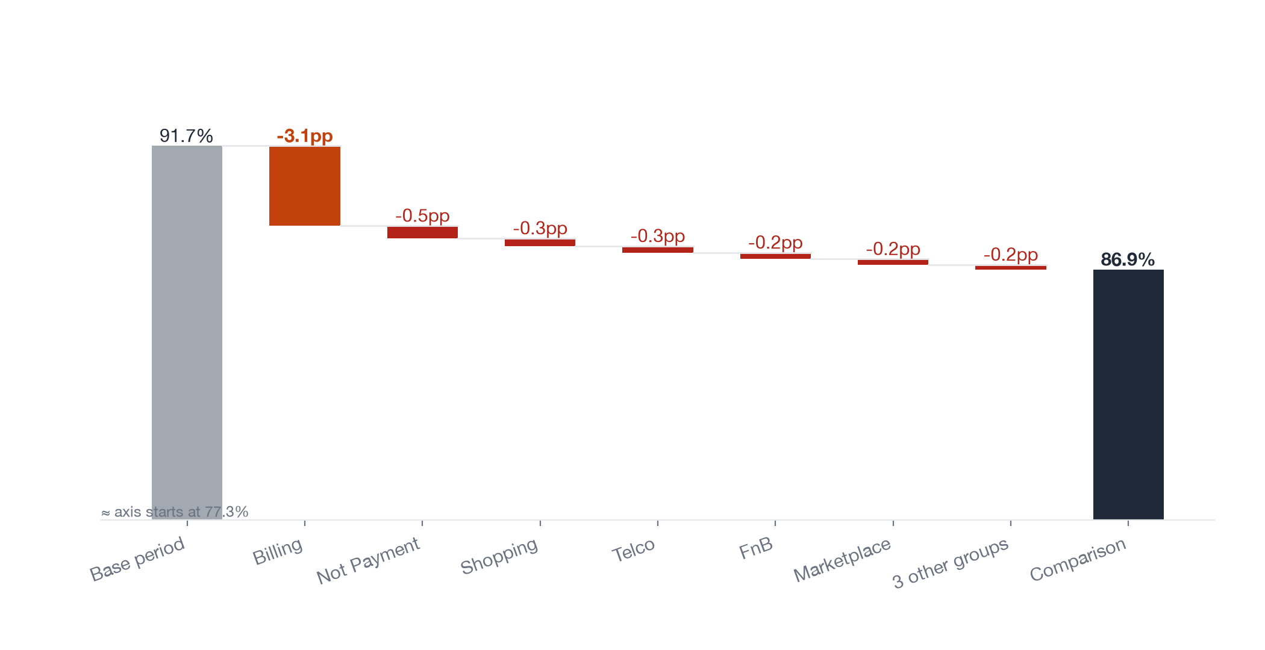
WHERE
Billing accounts for 64.5% of the drop: its success rate fell from 86.3% to 71.8%, all other categories only -2.0pp
64.5%
% of the total change from Billing
-14.5pp
Change in Transaction success rate, category=Billing
7.1x
How many times the change in Billing exceeds that of the rest
SO WHAT
Every next step of the investigation stays inside Billing. Bringing Billing alone back to its July level lifts the whole wallet by about 2.8pp.
Source: transactions_enhanced.csv (32,122 rows after filters); base period 7/2023, comparison period 8/2023.
05 / 14

Slide 6
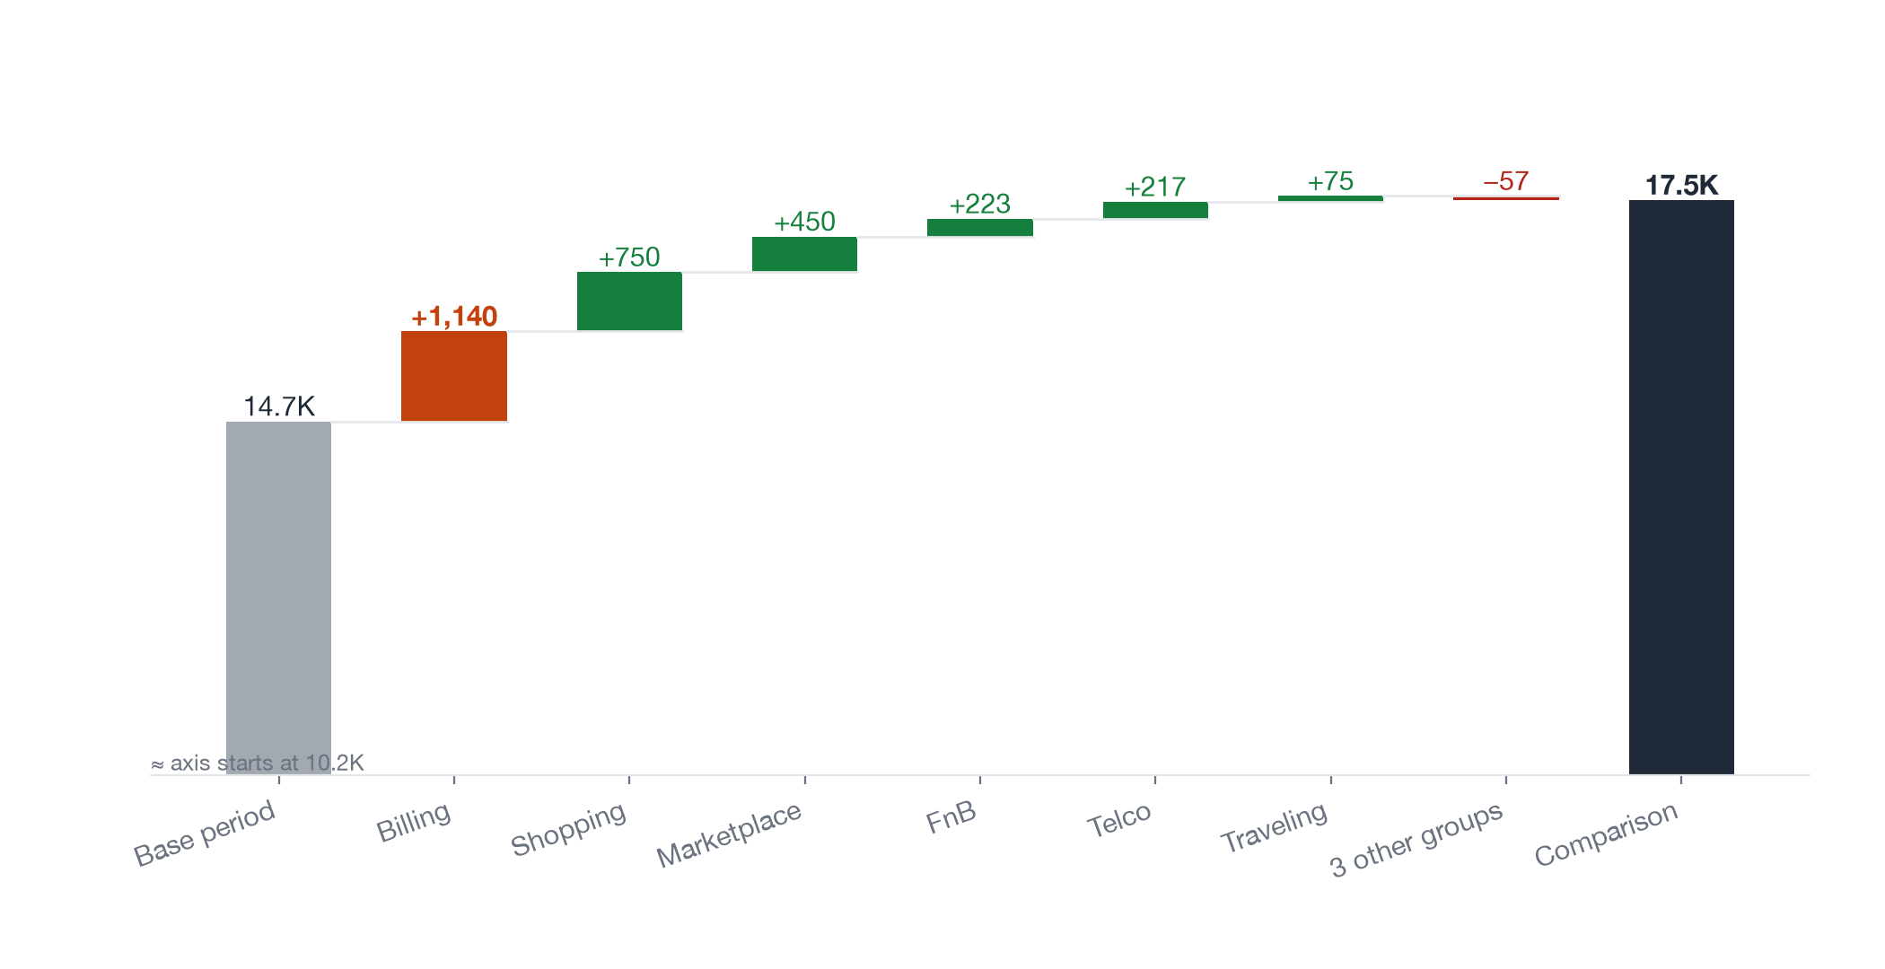
WHERE
Billing transactions rose from 2,280 to 3,420 (+50.0%), 40.7% of the wallet's total volume increase
+50.0%
% change in Transactions for Billing
40.7%
% of the total change from Billing
-0.9pp
Part of the change due to category mix (mix effect)
SO WHAT
Billing load grew fastest in the same month failures rose; the shift of mix toward Billing alone pulled the overall rate -0.9pp. This is context, not causal proof: compare against hourly infrastructure logs.
Source: transactions_enhanced.csv (32,122 rows after filters); base period 7/2023, comparison period 8/2023.
06 / 14

Slide 7
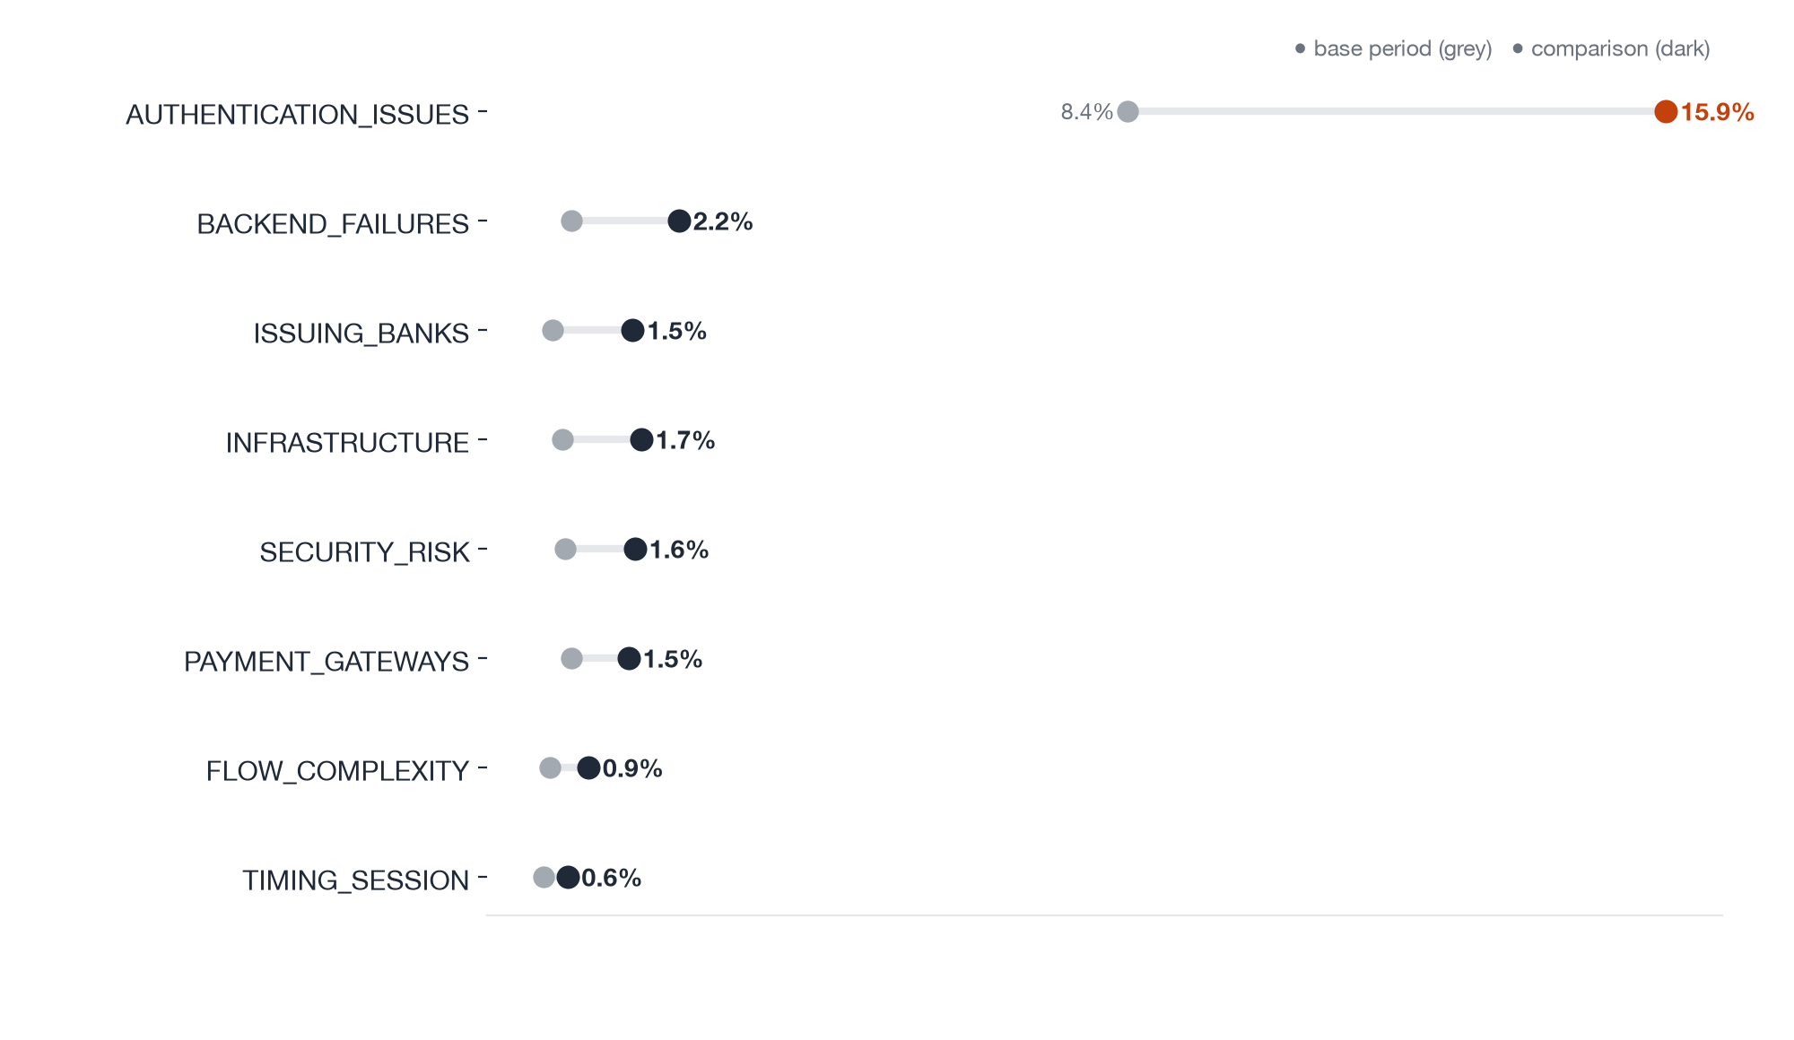
WHAT BROKE
Every error type in Billing rose; authentication errors are the largest, from 192 to 544 cases, 54.0% of the additional failures
54.0%
% of the increase in cases from error_category_l2=AUTHENTICATION_ISSUES
15.9%
error_category_l2=AUTHENTICATION_ISSUES as % of all rows (category = Billing), comparison period
3.5x
Cases in other error_category_l2 values: comparison period as a multiple of base
SO WHAT
Authentication is the largest fix (authentication failures went from 8.4% to 15.9% of Billing transactions), but the other error types grew even faster (3.5x): check the overall capacity of the Billing flow, not only OTP.
Source: transactions_enhanced.csv (32,122 rows after filters); base period 7/2023, comparison period 8/2023.
07 / 14

Slide 8
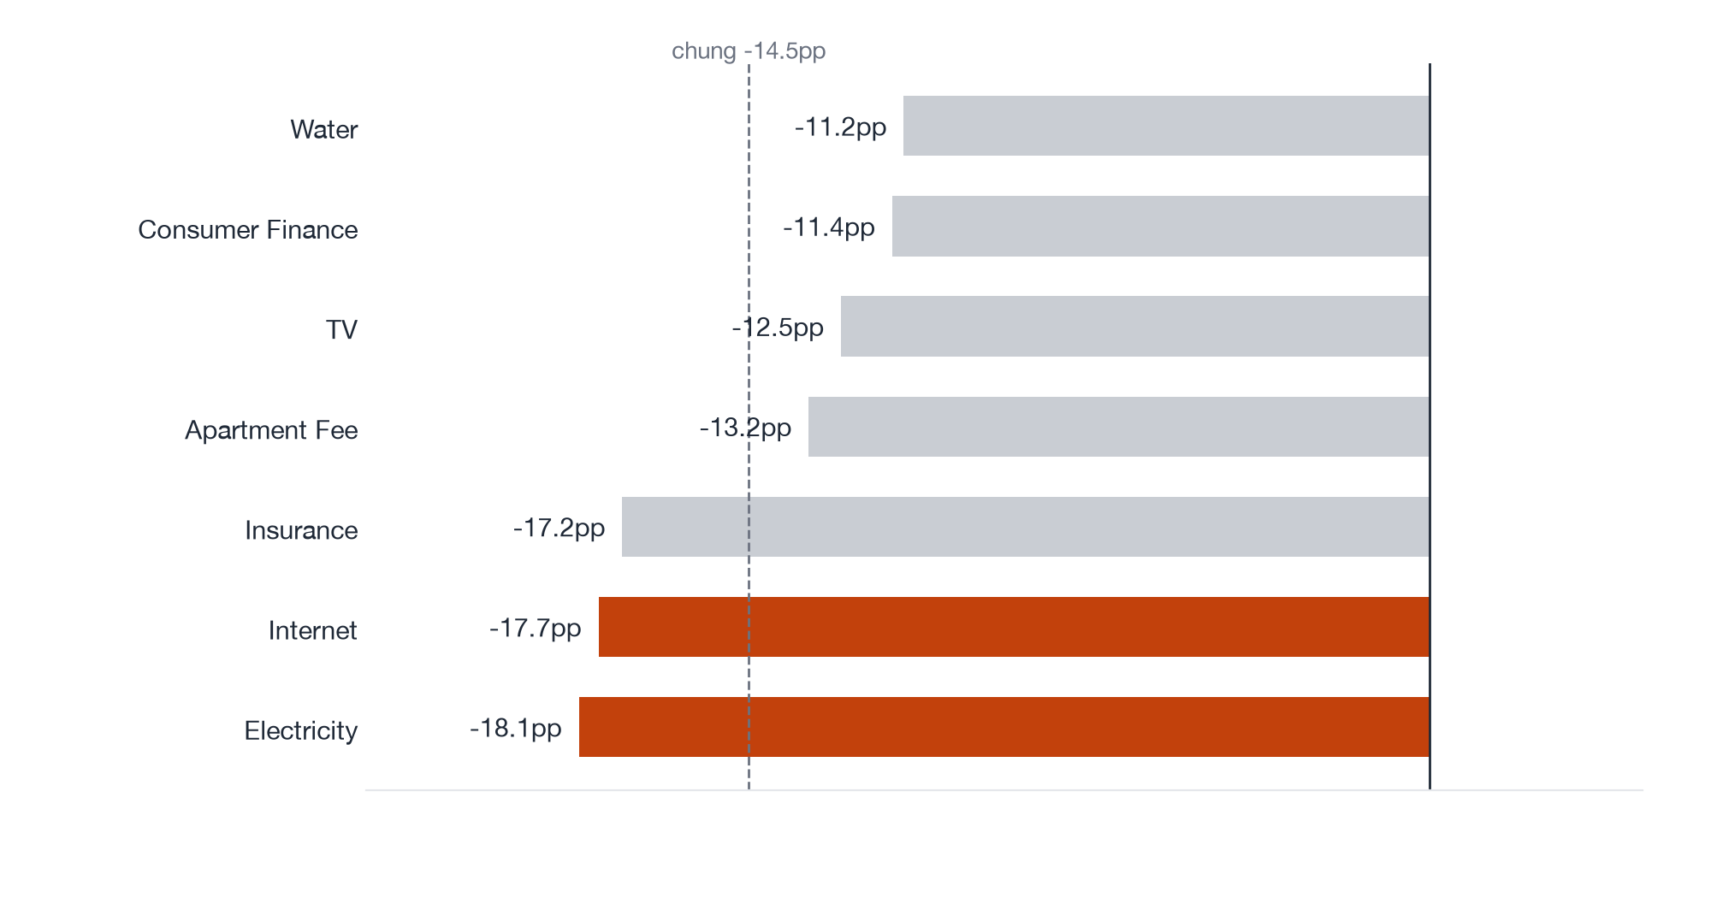
WHAT BROKE
Within Billing, Electricity (-18.1pp) and Internet (-17.7pp) fell more than Water (-11.2pp)
-18.1pp
Change in Transaction success rate, sub_category=Electricity
-11.2pp
Change in Transaction success rate, sub_category=Water
6.9pp
Max−min spread of the change across sub_category
SO WHAT
Every bill type fell at least 11.2pp, so billers are not the main source; still review the connections to the electricity and internet providers.
Source: transactions_enhanced.csv (32,122 rows after filters); base period 7/2023, comparison period 8/2023.
08 / 14

Slide 9
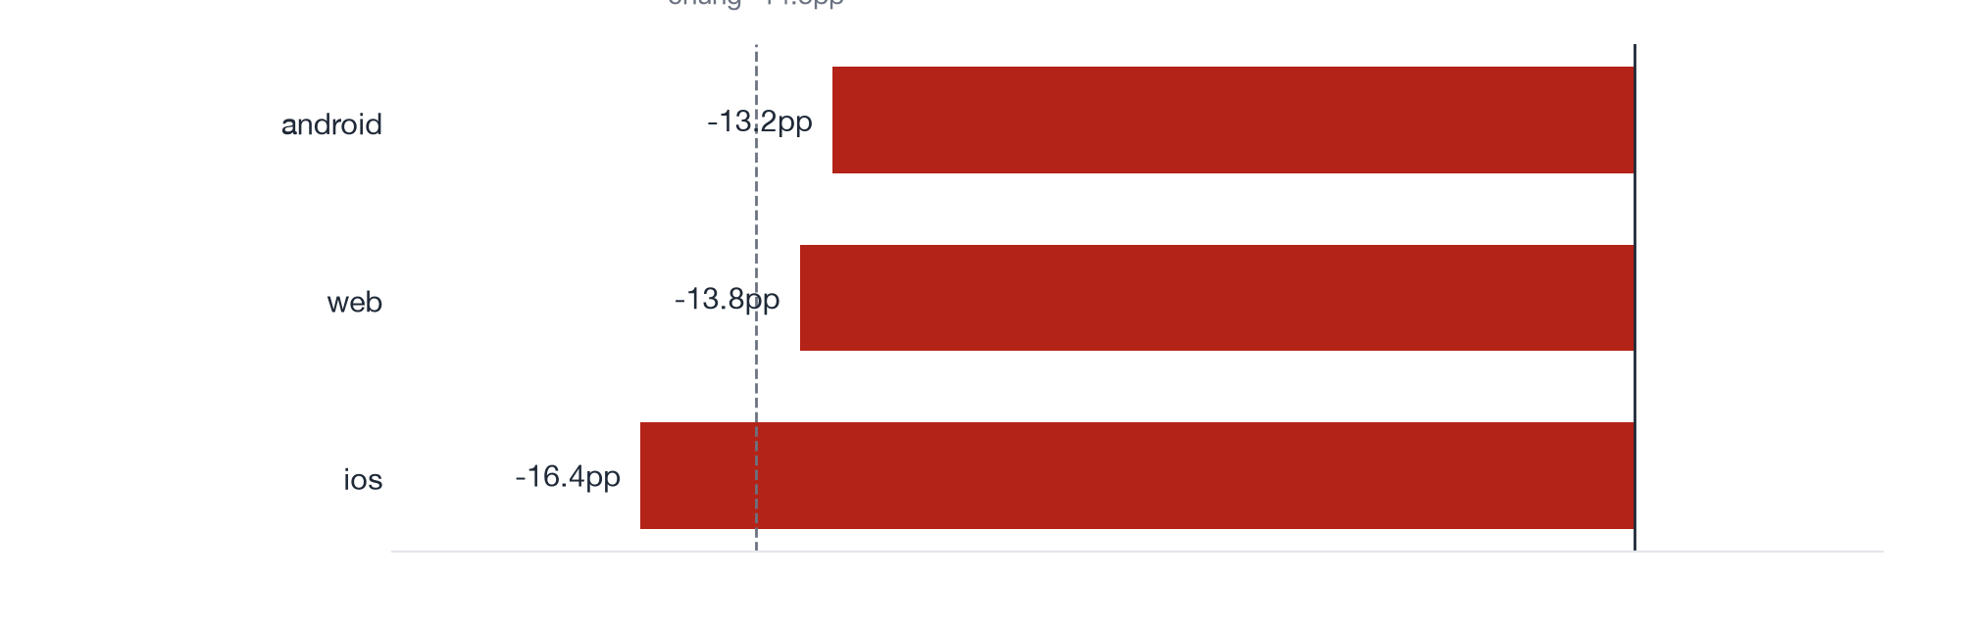
RULED OUT
All three platforms in Billing fell by about the same amount, from -13.2pp to -16.4pp: not an app-specific bug
3.2pp
Max−min spread of the change across platform
13.8pp
Typical size of the change (median |Δ|) across platform
-16.4pp
Change in Transaction success rate, platform=ios
SO WHAT
Hand the fix to backend and infrastructure; no Android/iOS/Web app hotfix is needed.
Source: transactions_enhanced.csv (32,122 rows after filters); base period 7/2023, comparison period 8/2023.
09 / 14

Slide 10
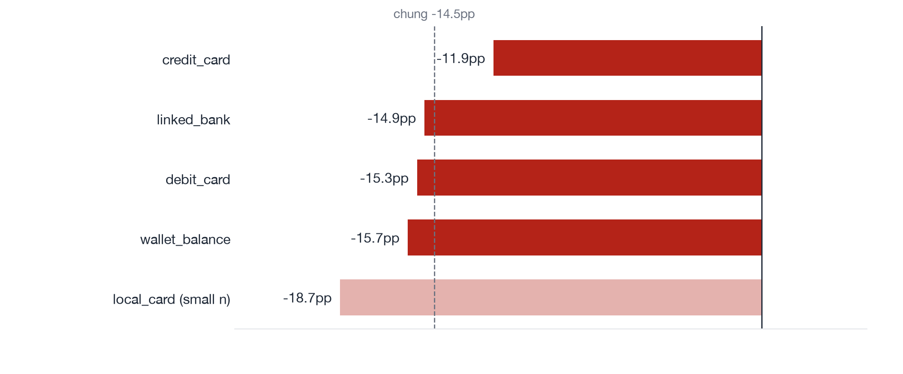
RULED OUT
The four main payment methods in Billing all fell, from -11.9pp to -15.7pp: the fault is not one bank or card partner
3.8pp
Max−min spread of the change across payment_method
-15.7pp
Change in Transaction success rate, payment_method=wallet_balance
-11.9pp
Change in Transaction success rate, payment_method=credit_card
SO WHAT
Rules out the payment-partner branch; even wallet balance (no bank involved) fell -15.7pp.
Source: transactions_enhanced.csv (32,122 rows after filters); base period 7/2023, comparison period 8/2023.
10 / 14

Slide 11
HYPOTHESIS TESTING
5 hypotheses supported by the data, 1 rejected, 1 not testable with the current data
ID | Hypothesis | Result | Evidence
H1 | The drop is concentrated in one category rather than spread evenly. | Supported | category = Billing: 86.3% → 71.8% (-14.5pp), 64.5% of the total change of -4.7pp; all other category values -2.0pp.
H2 | Within the most affected category, authentication errors (OTP/PIN) make up the majority of August failures. | Supported | Of 964 failed cases in the comparison period (category = Billing), error_category_l2 = AUTHENTICATION_ISSUES accounts for 56.4% (base period 61.5%, cases up 2.8x). As % of all rows: AUTHE…
H3 | Within the most affected category, every platform dropped about the same, so the fault is server-side rather than an app bug. | Supported | By platform (category = Billing): android -13.2pp, ios -16.4pp, web -13.8pp. Spread across groups 3.2pp vs a typical change of 13.8pp → the change is uniform.
H4 | Within the most affected category, every payment method dropped about the same, so it is not the fault of one bank or card partner. | Supported | By payment_method (category = Billing): credit_card -11.9pp, debit_card -15.3pp, linked_bank -14.9pp, wallet_balance -15.7pp. Spread across groups 3.8pp vs a typical change of 15.1pp → th…
H5 | Transaction volume in the most affected category rose sharply in August. | Supported | category = Billing: 2,280 → 3,420 (+1,140), 40.7% of the total change of +2,798; all other category values +1,658.
H6 | Inside the most affected category, the drop is spread evenly across bill sub-categories. | Rejected | By sub_category (category = Billing): Apartment Fee -13.2pp, Consumer Finance -11.4pp, Electricity -18.1pp, Insurance -17.2pp, Internet -17.7pp, TV -12.5pp, Water -11.2pp. Spread across g…
H7 | Users drop off between authentication and payment confirmation and retry several times. | Not testable | Needs event_logs (funnel and path); the transaction file has no step-level data.
Source: transactions_enhanced.csv (32,122 rows after filters); base period 7/2023, comparison period 8/2023.
11 / 14

Slide 12
RECOMMENDATIONS
September priorities: stabilise the Billing flow within 2 weeks, then test an alternative authentication method
# | Action | Owner | Timeline | KPI to track | Type
1 | Monitor the Billing success rate hourly and alert when it drops below the July level (86.3%) — Catch overload hours early instead of waiting for the monthly report | Head of Payments | Within 1 week | Hourly Billing success rate | Quick win
2 | Load-test the OTP gateway and the Billing backend at 3,420 transactions/month; raise the quota or add a backup SMS provider — Restoring Billing to 86.3% at August volume would lift the whole wallet by about 2.8pp | Engineering Lead | Within 2 weeks | Billing failures per month (August: 964) | Quick win
3 | Review the connections to the electricity and internet providers, the two bill types with the largest drops — Close the 6.9pp gap between bill types | Partnerships Manager | Within 2 weeks | Billing success rate by bill type | Quick win
4 | A/B test biometric authentication instead of OTP for bill payments (design from baseline, MDE, α 0.05, power 80%) — Target: bring Billing authentication failures from 15.9% back to 8.4% as in July | Payments Product Manager | Design in September, run for 3–4 weeks | Authentication failure rate on Billing transactions | Big project
5 | Add event logging to the bill-payment flow to build the funnel and paths: where users drop and whether they retry | Analytics Lead | Within 4 weeks | Billing funnel covering every step from bill selection to confirmation | Big project
Source: transactions_enhanced.csv (32,122 rows after filters); base period 7/2023, comparison period 8/2023.
12 / 14

Slide 13
LIMITATIONS
What the current data cannot answer
• The transaction file has no event log, so step-by-step funnel and path analysis cannot be built (needs event_logs.csv).
• 734 failed transactions have no error category; error-type shares are computed on labelled cases.
• There is no experiment data, so the alternative authentication fix is a proposal that needs an A/B test.
• Only two periods (July and August) exist, so seasonality cannot be separated.
NEXT STEPS
→ Analyse event_logs.csv to build the funnel and post-authentication-failure paths (hypothesis H7 not yet testable).
→ Match hourly infrastructure logs (OTP gateway, Billing backend) against transaction volume to test the overload hypothesis.
→ Re-label the failed transactions that are missing an error category.
→ Find out why categories outside Billing also fell -2.0pp.
Source: transactions_enhanced.csv (32,122 rows after filters); base period 7/2023, comparison period 8/2023.
13 / 14

Slide 14
APPENDIX
KPI definitions, filters and data volume
• Primary KPI: Transaction success rate — Share of rows where status = success
• Dataset: transactions_enhanced.csv · 32,122 raw rows · 32,122 rows after filters
• Filters: none
• Comparison: base = 7, comp = 8; periods in the data: 7, 8
• Shift-share decomposition: total Δ = Σ rate effect (performance within each group) + Σ mix effect (group mix).
• Every number in this deck traces back to facts.json (QA gate).
Source: transactions_enhanced.csv (32,122 rows after filters); base period 7/2023, comparison period 8/2023.
14 / 14

